Slide 1
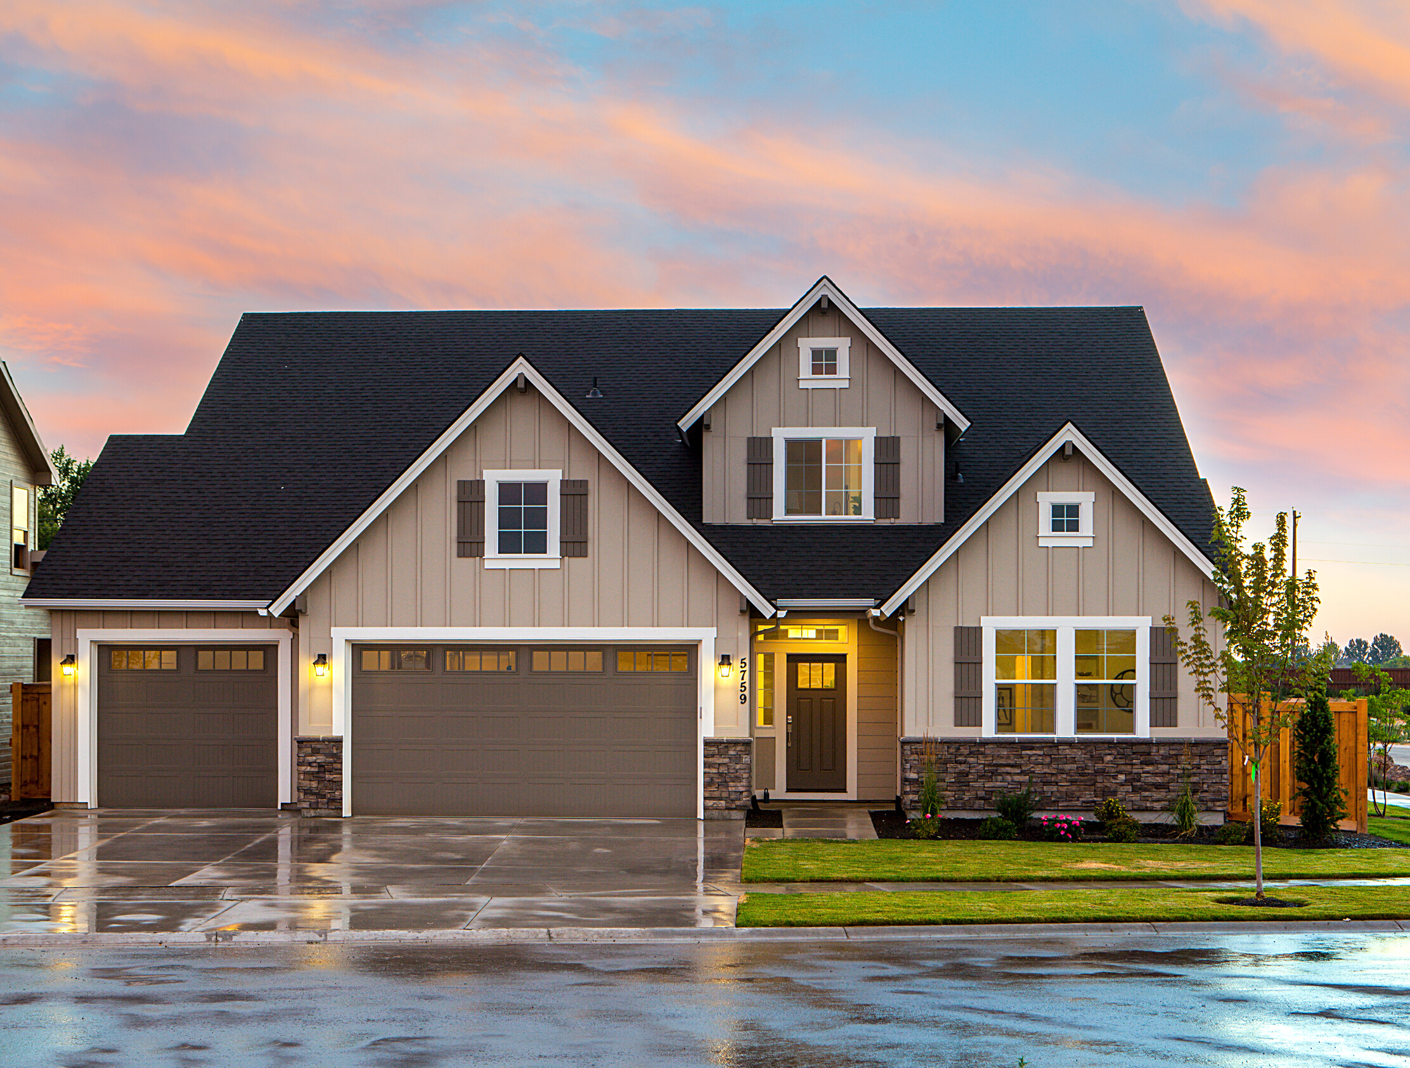
Identifying Factors that drive home prices
by Maria J. Cobos
FEBRUARY 06, 2021

Slide 2
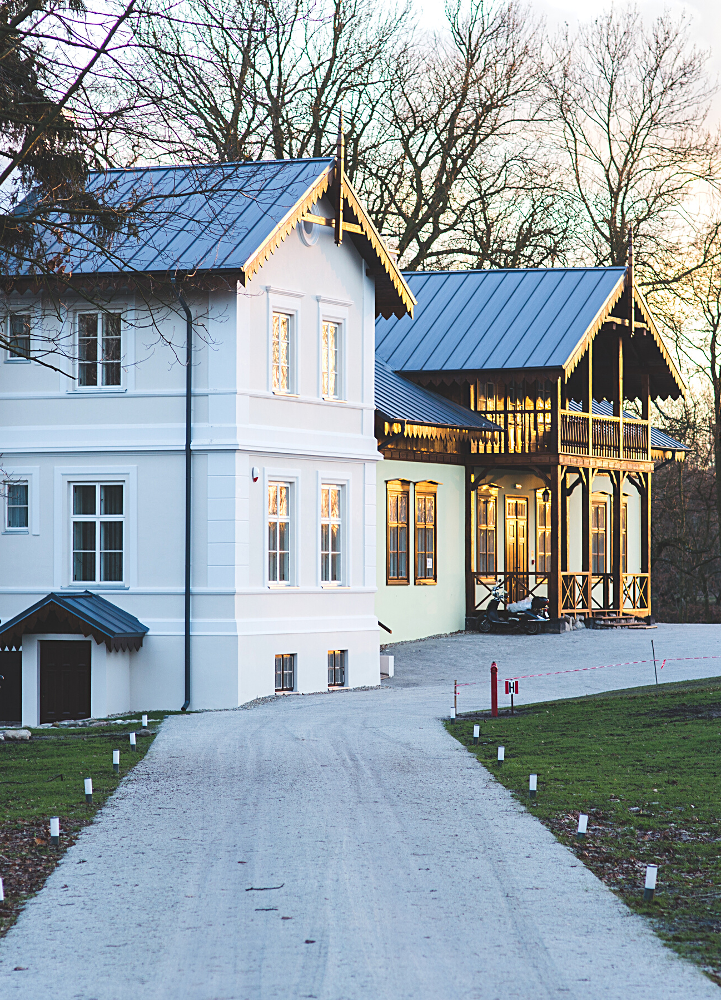
Problem Statement and goal
PROBLEM
Investors want to maximize the yield on MBS investments and minimize the risk associated with a pool of loans.
GOAL
Look into the factors that drive home prices, so our business can make informed decisions to allocate dollars earmarked for investment into MBS.
01–10

Slide 3
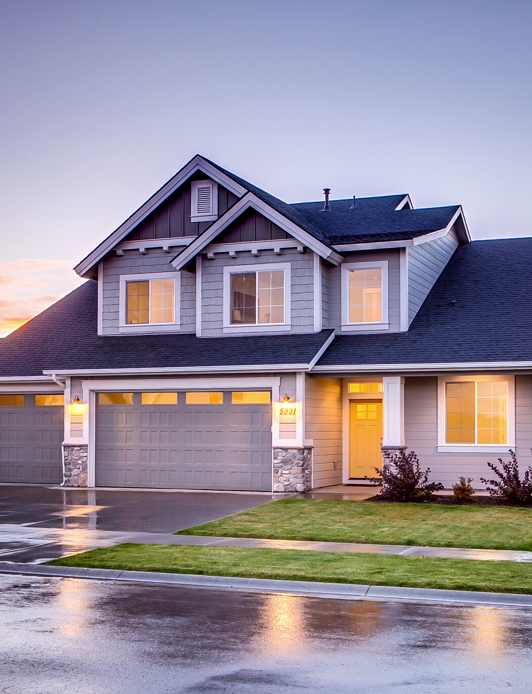
Hypothesis Analysis
Some of the biggest driving factors for home pricing would be:
HOUSE FACTORS
Quality of materials
Living area size
Number of rooms and bathrooms
Garage size
Year built
EXTERNAL FACTORS
Economy growth, affordability of housing, supply of housing and stock market influence the house market. No data to analyze.
02–10

Slide 4
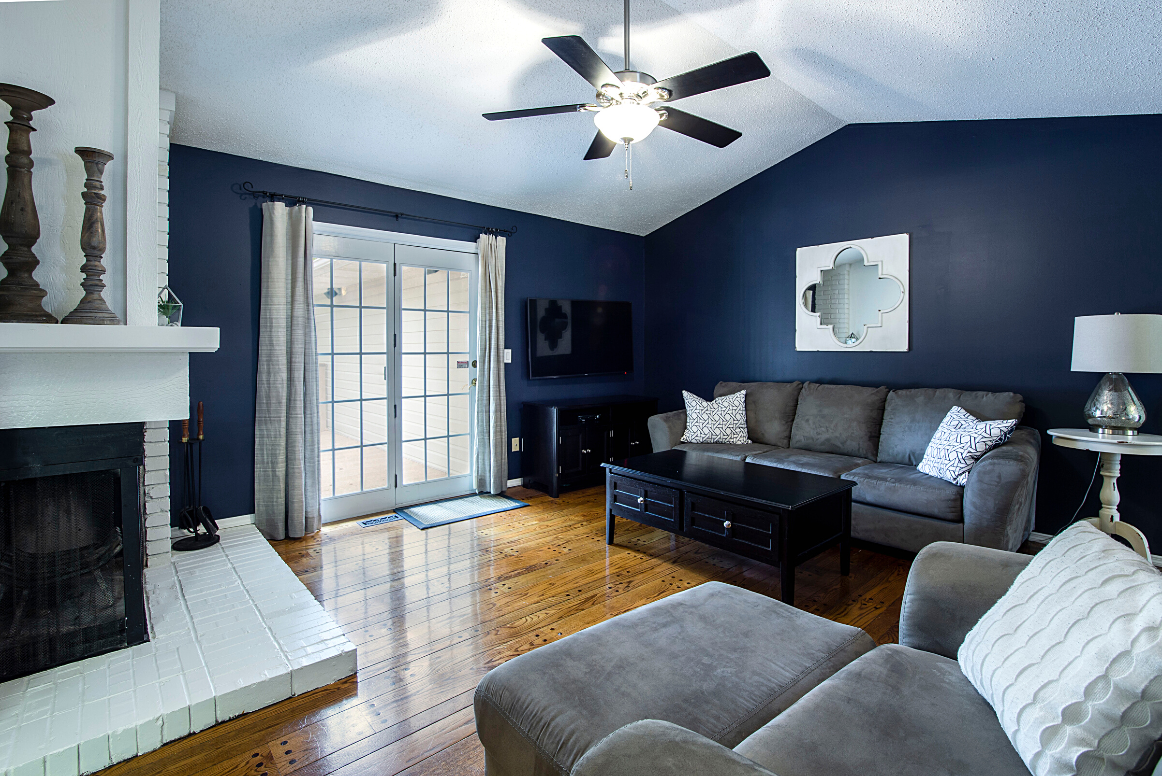
Data Description
1460 observations from Ames Housing Dataset
79 explanatory variables
36 numerical variables
Raw data from Kaggle: https://www.kaggle.com/alphaepsilon/housing-prices-dataset
Train dataset used for analysis
03–10

Slide 5
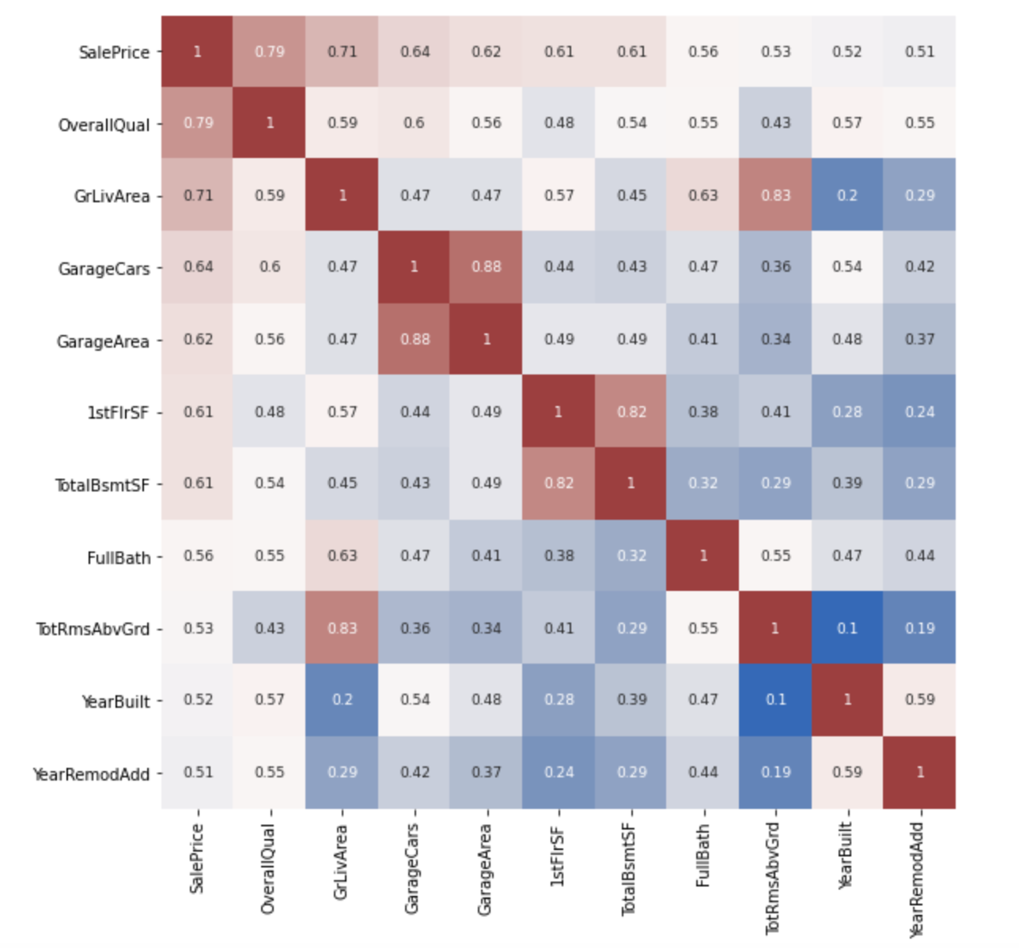
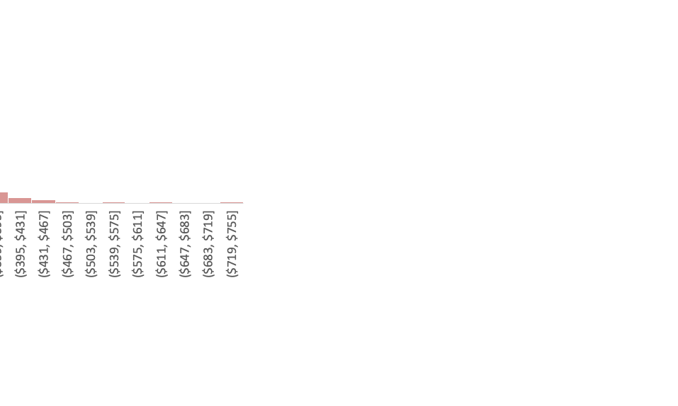
Exploratory Data Analysis
Metric | Value
Mean | $180,921.19
Standard Error | $2,079.10
Median | $163,000
Mode | $140,000
Range | $34,900-$755,000
Most of our variables can be approximated to a normal distribution.
04–10

Slide 6
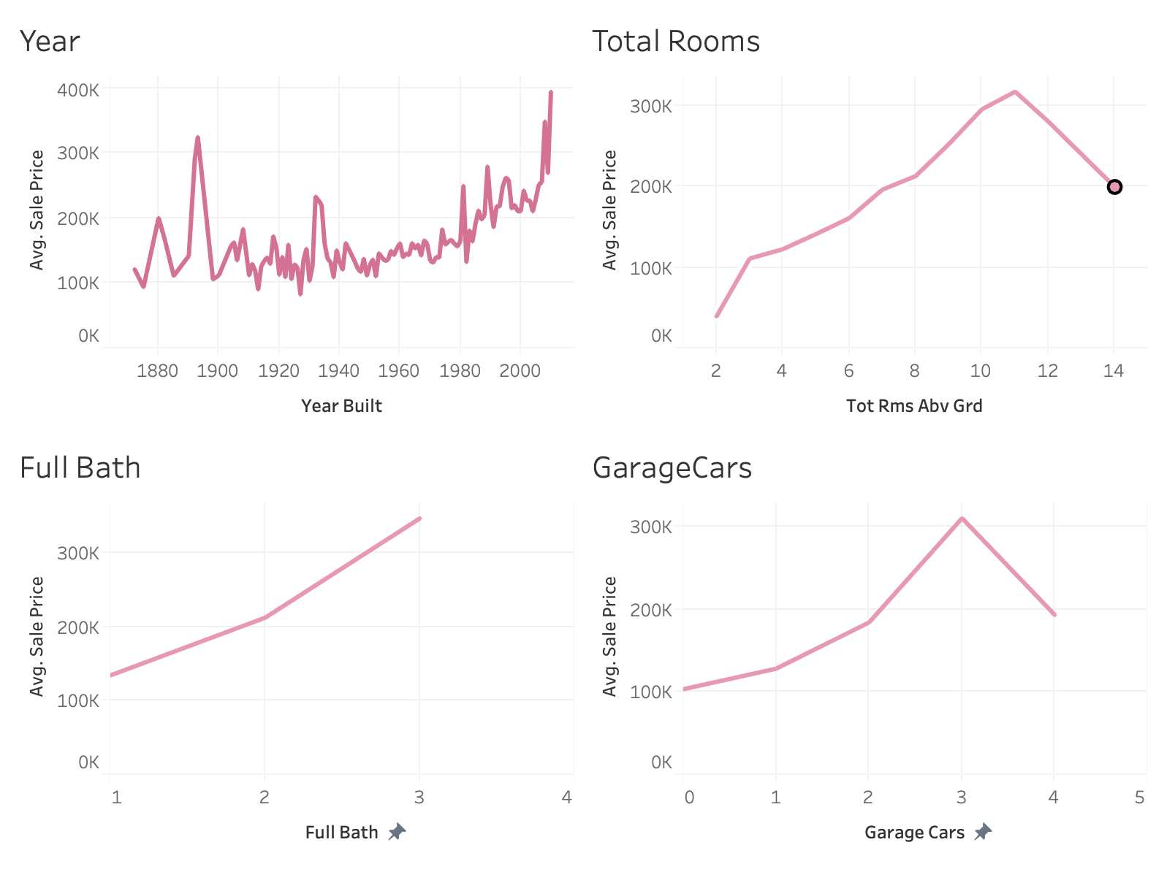
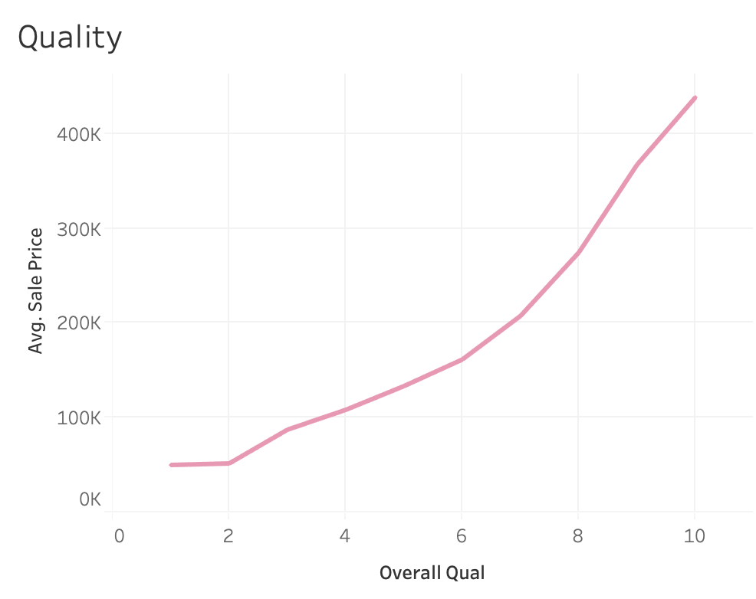
Exploratory Data Analysis:
Numerical Variables
Highly Correlated Variables with Average House Prices:
Overall Quality
Living Area Size
Size of garage in car capacity
First Floor Area
Number of Full Bathrooms
Number of Rooms
Year built
05–10

Slide 7
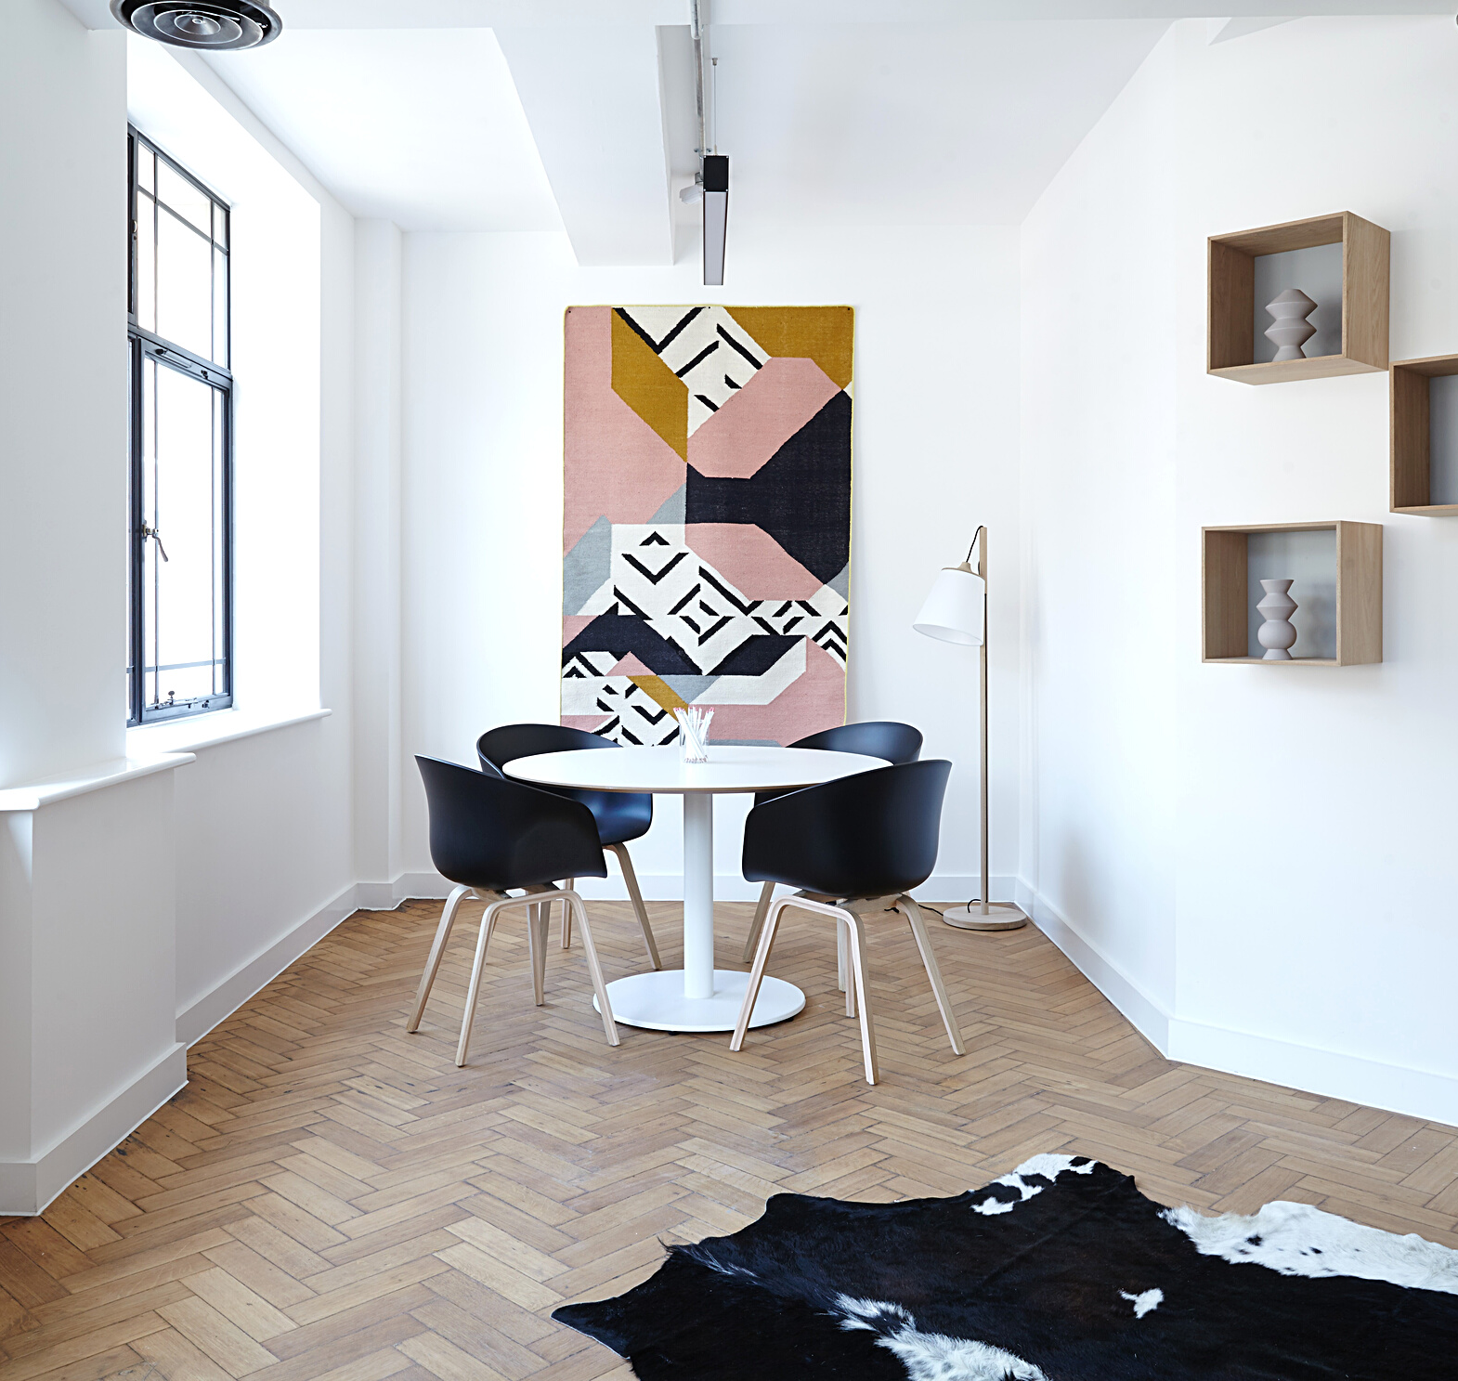
Method: A/B test
T-test and Z-test
Split sales prices in treatment and control variables.
Test on numerical and categorical variables.
Excel ToolPak to obtain P-value.
P-value <= 0.05 to reject the null hypothesis.
Null hypothesis: There is no significant difference between the means of home prices when:
Quality is better
Year built is different
House includes a garage
Living area is larger
06–10

Slide 8
Results: T-test on Sales Price
With 95% confidence, home prices are between $70K and $84K higher for newer houses.
With 95% confidence, home prices are between
$80K and $92K higher for good quality houses.
With 95% confidence, home prices are between $93K and $115K higher for larger living area houses (>1800 sf).
07–10

Slide 9
Results: Z-test on Quality Score
With 95% confidence, quality rates are higher
between 40% and 57% of houses with garage.
With 95% confidence, quality rates are higher between 30% and 39% of larger living area houses (>1800 sf).
08–10

Slide 10
Results: T-test and categorical variables
With 95% confidence, home prices are between
$25K and $56K higher for abnormal sale houses (foreclosure, short sale).
With 95% confidence, home prices are between $62K and $85K higher for houses with normal condition garage.
09–10

Slide 11

Discussion and Recommendations
The highly correlated numerical variables with home prices are:
Overall Quality
Living Area (SF)
Garage Size in car capacity
First Floor Area (SF)
Year Built
Quality variable is related not only with high quality materials but living area size and garage size in car capacity.
These findings can be leveraged to predict home prices based on the highly correlated variables found in this study using regression methods.
10–10

